Slide 1
01. Introduction, Review of DAA 1
Design and Analysis of Algorithm (DAA) 2
2016/2017
Abdul Munif

Slide 2
Note on English lecture (1/2)
Lecture will be delivered in English, and optionally in Bahasa Indonesia if needed.
All written tests (midterm, quiz, final exam) also in English.
I encourage you to use English for in-class discussion

Slide 3
Note on English lecture (2/2)
To encourage English usage, please refrain yourself from being a ‘grammar NAZI’.
Use:
simple vocabularies,
simple grammar.

Slide 4
Course Materials
Book
T. H. Cormen, C. E. Leiserson, R. L. Rivest, and C. Stein, Introduction to Algorithms, Third Edition. Cambridge: The MIT Press, 2009.
Presentations & other materials
https://github.com/munif/paa-2

Slide 5
Introduction

Slide 6
What will I learn?
In this lesson, you will learn several topics, including:
Syllabus
Review of DAA 1
Problem solving approach

Slide 7
Why learn it?
Purpose
By knowing the syllabus, you will know the ‘big picture’ of what we learn in this lecture.
Recap from DAA 1, we will use complexity analysis to determine the efficiency of algorithm.
We will have new approaches to solve computing problems: DP (dynamic programming), Greedy algorithm

Slide 8
Marking
Quiz 1: 20%
Quiz 2: 20%
Midterm Exam: 25%
Final Exam: 25%
Exercise: 10%

Slide 9
Review of PAA 1

Slide 10
Review of PAA 1
Pseudocode convention
Running time (algorithm complexity)
Asymptotic Notation

Slide 11
Pseudocode Convention
Introduction to Algorithm, page 20-22

Slide 12
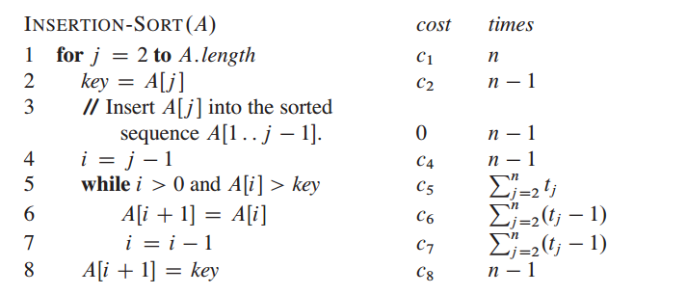
Algorithm Complexity
Iterative

Slide 13
Algorithm Complexity
Recursive → recurrence form
Substitution
Recursion Tree
Master Method

Slide 14
Recursive: Substitution

Slide 15
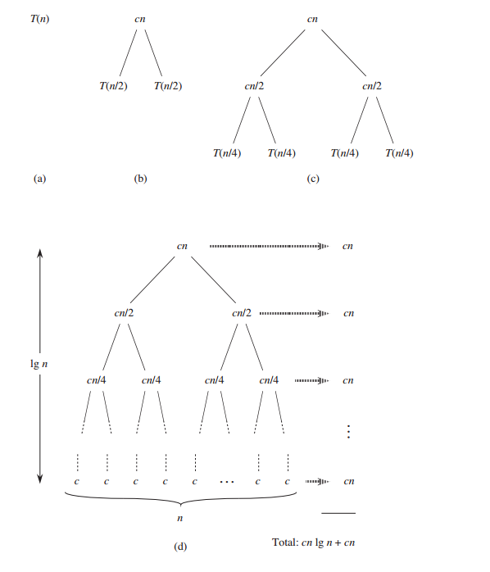
Recursive: Recursion Tree

Slide 16
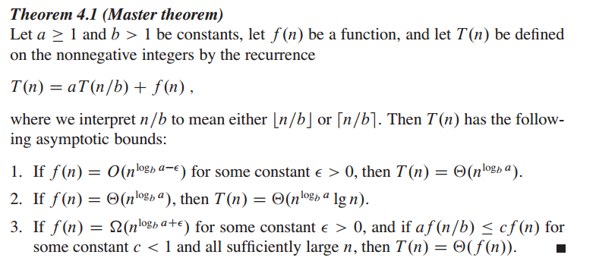
Master Method

Slide 17
Recursive: Master Method

Slide 18
Asymptotic Notation

Slide 19
Asymptotic Notation

Slide 20
Problem Solving Approach

Slide 21
Problem Solving Approach
Observation
Looking for a pattern
Abstraction
Define a pattern → recurrence, iteration
Simplification
Pseudocode
Source code

Slide 22
Example: Fibonacci
We can solve Fibonacci problem using:
Iterative
Recursive
Dynamic Programming → ‘memo table’

Slide 23
Fibonacci: Iterative

Slide 24
Fibonacci: Recursive

Slide 25
Dynamic Programming
Characterize the structure of an optimal solution.
Recursively define the value of an optimal solution.
Compute the value of an optimal solution, typically in a bottom-up fashion → saved in ‘memo’
Construct an optimal solution from computed information

Slide 26
Dynamic Programming (DP)
From RECURSIVE
DP
TOP-DOWN
From ITERATIVE
DP
BOTTOM-UP
http://algorithms.tutorialhorizon.com/introduction-to-dynamic-programming-fibonacci-series/

Slide 27
Fibonacci-DP (top-down)

Slide 28
Fibonacci-DP (bottom-up)

Slide 29
Example: 2-power-of-n
Define an algorithm (pseudocode) to calculate 2^{n} using these approaches:
iterative
Recursive →
Note: Do not use standard library pow(x, n)

Slide 30
Example: 2-power-of-n (iterative)

Slide 31
Example: 2-power-of-n (recursive)

Slide 32
Changing from recursive to DP

Slide 33
DP Bottom Up
Define ‘bottom’ solution → base case on recurrence
Define a strategy for solving overlapping sub-problems

Slide 34
The differences of DP Top Down vs DP Bottom Up
DP Top Down
DP Bottom Up
recursive + memo → DP
Based on recurrence
iterative
Define a new solutions

Slide 35
The differences of DP Top Down vs DP Bottom Up
DP Top Down
DP Bottom Up
Direction of solving the problem → top
Each case will returning the result → recursion
Recursion → DP
Direction of solving the problem → bottom
The result will be returned at the end of algorithm/iteration
Define a new approach → regular iteration

Slide 36
Terminology
iterative algorithm
recurrence
substitution method
recursion tree
master method
asymptotic notation
dynamic programming
memo table
DP top-down
DP bottom-up

Slide 37
Summary
Pseudocode convention
Complexity analysis: iterative, recursive
Asymptotic notation
Examples:
Fibonacci: iterative, recursive, DP

